Slide 1
INT222 Advance Web Development
BY : DIVYA THAKUR
UID:28300

Slide 2
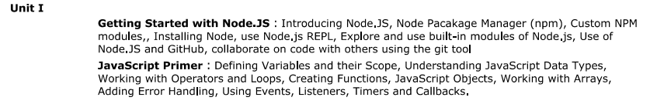

Slide 3
Introduction
Node.js is a javascript runtime built on chrome v8 javascript engine.
It is a javascript running on the server.
Node.js runs the V8 JavaScript engine, the core of Google Chrome, outside of the browser. This allows Node.js to be very performant.
Node.js runs on various platforms (Windows, Linux, Unix, Mac OS X, etc.)

Slide 4
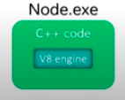
in 2009. Ryan Dahl created node js
When to use NODE JS :
I/0 BOUND
DATA STREAMING APPLICATIONS
REAL TIME CHAT SYSTEMS

Slide 5
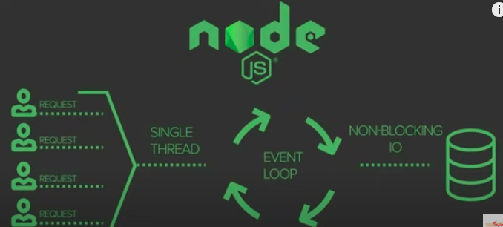

Slide 6
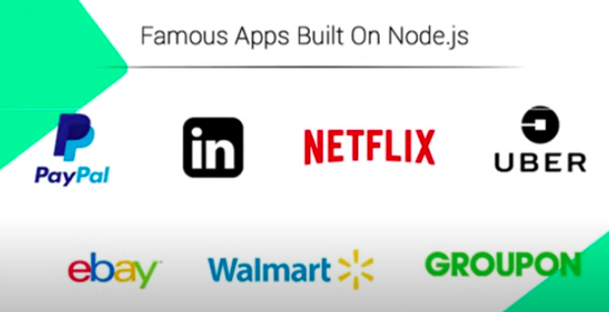

Slide 7
Installation Of Node
Go to nodejs.org and download the version which is recommended for most users.
Open cmd write node -v
Run npm -v
IDE : Visual Studio Code
Open visual studio code :
run same commands as above
one of the reaons for using visual studio code is the inbuilt terminal.
NOTE : NPM IS NODE PACKAGE MANAGER

Slide 8
NODE JS REPL
REPL is a feature of node useful for experimenting with node js code and debugging javascript codes.
REPL stands for :
READ : Reads user input ,parses it into javascript data structure and stores in the memory
EVAL : Takes and evaluate the data structure
PRINT: Print the result
LOOP: Loop the command until user pressed ctrl+c twice.
The REPL is bundled with every Node.js installation and allows you to quickly test and explore JavaScript code within the Node environment without having to store it in a file.

Slide 9
If you have node installed, then you also have the Node.js REPL.
To start it, simply enter in your command line shell:
node
This results in the repl prompt in cmd:
>
The > symbol lets you know that you can enter JavaScript code to be immediately evaluated.
Perform any operation and press enter to see the results.
To exit the REPL, you can type .exit, or press CTRL+D once, or press CTRL+C twice, which will return you to the shell prompt.

Slide 10
Executing Code in the Node.js REPL
The REPL is a quick way to test JavaScript code without having to create a file. Almost every valid JavaScript or Node.js expression can be executed in the REPL.
TASKS
Perform Operations (add,multiply,divide,subtract)
Perform operations on strings
Multiline Code.
Calling Function:
When writing Node.js code, it’s common to print messages via the global console.log method or a similar function.
Creating Variables
Access last value using underscore( _ ).

Slide 11
To list all the available commands, use the .help command
All the properties ,methods inside nodejs can be seen with the help of tapping TAB twice in REPL.

Slide 12
Node Package Manager
npm is the package manager for the Node JavaScript platform. It puts modules in place so that node can find them, and manages dependency conflicts intelligently.
Node Package Manager (NPM) is a command line tool that installs, updates or uninstalls Node.js packages in your application.
It is also an online repository for open-source Node.js packages.
The node community around the world creates useful modules and publishes them as packages in this repository.

Slide 13
NPM is included with Node.js installation. After you install Node.js, verify NPM installation by writing the following command in terminal or command prompt
npm -v
It is extremely configurable to support a variety of use cases. Most commonly, you use it to publish, discover, install, and develop node programs.
Run npm help to get a list of available commands.
npm consists of three distinct components:
the website
the Command Line Interface (CLI)
the registry

Slide 14
The npm registry contains packages, many of which are also Node modules, or contain Node modules.
About packages
A package is a file or directory that is described by a package.json file. A package must contain a package.json file in order to be published to the npm registry.
A package.json file:
lists the packages your project depends on
specifies versions of a package that your project can use using semantic versioning rules
makes your build reproducible, and therefore easier to share with other developers

Slide 15
Package
Downloading a package is very easy.
Open the command line interface and tell NPM to download the package you want.
npm install packagename
NPM creates a folder named "node_modules", where the package will be placed. All packages you install in the future will be placed in this folder.

Slide 16
The name npm (Node Package Manager) stems from when npm first was created as a package manager for Node.js.
All npm packages are defined in files called package.json.
The content of package.json must be written in JSON.
At least two fields must be present in the definition file: name and version.
npm can manage dependencies.
npm can (in one command line) install all the dependencies of a project.
Dependencies are also defined in package.json.
You can publish any directory from your computer as long as the directory has a package.json file.

Slide 17
Update package
To update the package installed locally in your Node.js project, navigate the command prompt or terminal window path to the project folder and write the following update command.
C:\Project> npm update <package name>

Slide 18
Unistall packages
Use the following command to remove a local package from your project.
C:\>npm uninstall <package name>

Slide 19
NPM Modules
A module is any file or directory in the node_modules directory that can be loaded by the Node.js require() function.
To be loaded by the Node.js require() function, a module must be one of the following:
1. A folder with a package.json file containing a "main" field.
2. A JavaScript file.

Slide 20
Since modules are not required to have a `package.json` file, not all modules are packages. Only modules that have a `package.json` file are also packages.
In the context of a Node program, the module is also the thing that was loaded from a file. For example, in the following program
var req = require('request')
we might say that "The variable req refers to the request module".

Slide 21
Custom NPM Modules
Node.js modules are a type of package that can be published to npm.
Steps:
Create a package.json file
Create the file that will be loaded when your module is required by another application
Test your module

Slide 22
Node JS Core Module/Built-in Module
Consider modules to be the same as javascript libraries.
A set of functions you want to include in your application.
Nodejs has some built in modules.
It is a simple or complex functiionality organised in single or multiple javascript files which can be reused throughout node js applications.
Core module includes functionalities of nodejs.They load automatically when the nodejs process starts.
However ,you have to import (require) the core modules first in order to use it in the application.

Slide 23
Built-in modules
File System Module
Buffer Module
Stream Module
Timers
Events
HTTP ,HTTPS
Query String
Path

